Slide 1
What is statistics?
Sampling populations
Frequency and probability distributions

Slide 2
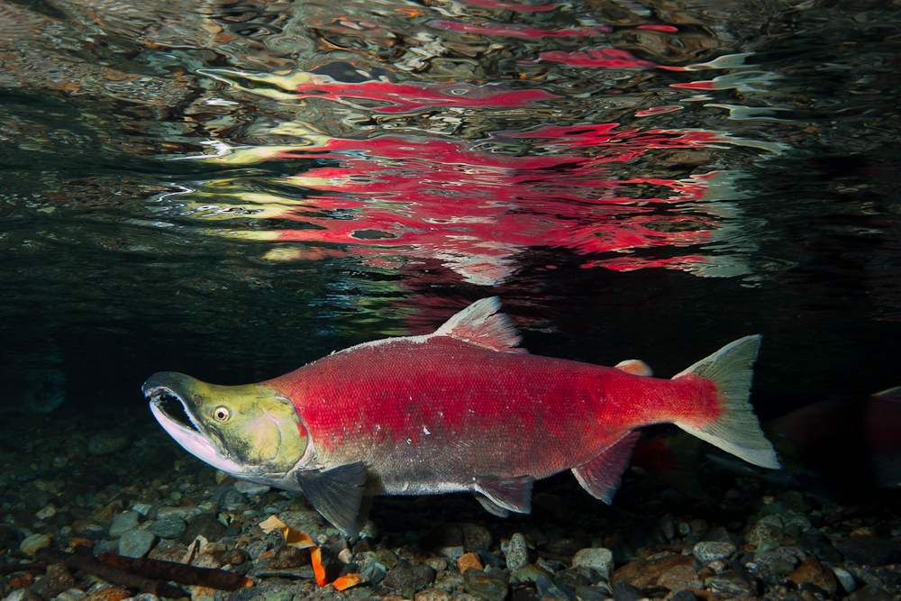
How much does this salmon weigh?
Weight (kg) = 3.09

Slide 3
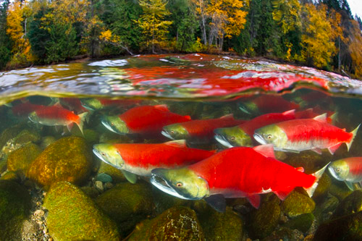
How much do these salmon weigh?
Weight (kg): 2.91, 3.06, 2.69, 2.88, 2.98, 1.61, 2.16, 1.56, 1.79, 3.3, 1.91, 1.99, 1.69, 1.44

Slide 4
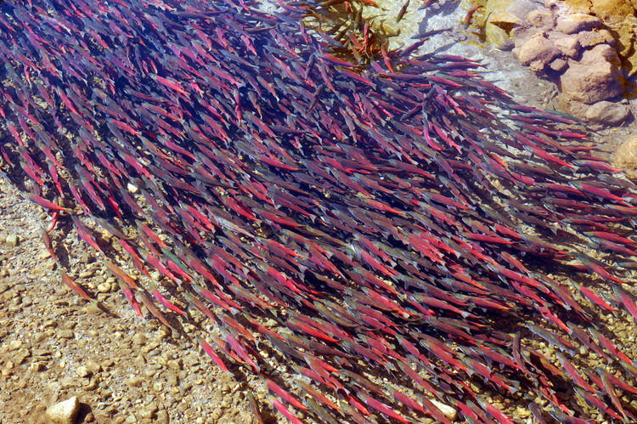
How about the salmon in this river?

Slide 5
Weight (kg):
3.09, 2.91, 3.06, 2.69, 2.88, 2.98, 1.61, 2.16, 1.56, 1.76, 1.79, 3.3, 1.91, 1.99, 1.69, 1.44, 3.25, 2.18, 2.13, 1.25, 2.33, 1.95, 2.56, 1.76, 1.53, 1.66, 1.81, 1.7, 1.84, 1.52, 1.75, 1.39, 2.62, 1.58, 1.83, 1.54, 1.76, 1.99, 3.53, 1.6, 1.85, 1.85, 1.72, 3.3, 2.87, 3.08, 3.27, 1.47, 2.29, 1.7, 2.83, 2.93, 1.88, 3, 1.74, 3.21, 1.74, 2.02, 2.92, 3.49, 1.89, 1.83, 1.67, 1.9, 1.99, 1.83, 2.9, 2.76, 2.04, 2.03, 1.6, 2.02, 3.04, 2.68, 2.32, 1.98, 1.94, 1.58, 1.94, 2.5, 1.91, 2.66, 1.9, 2.13, 1.97, 3.11, 2.36, 1.84, 1.96, 1.8, 3.11, 1.89, 2.03, 1.75, 2.94, 1.89, 2, 1.76, 3.07, 1.79, 1.67, 3, 1.99, 2.81, 1.94, 1.41, 1.91, 1.64, 1.81, 1.88, 1.5, 1.77, 1.96, 1.9, 2.26, 1.7, 1.78, 1.53, 1.94, 2.42, 2.75, 1.61, 1.87, 1.84, 1.6, 1.82, 2.07, 1.35, 2.95, 1.55, 1.42, 1.74, 2.03, 3, 1.7, 1.57, 1.73, 2.12, 2.82, 1.93, 1.9, 1.46, 1.61, 1.6, 1.74, 1.59, 1.65, 2.87, 1.98, 1.62, 2.78, 1.65, 1.82, 1.64, 1.78, 1.18, 1.44, 1.87, 1.76, 1.6, 1.59, 2.58, 1.41, 1.89, 1.62, 2.7, 1.63, 1.94, 2.14, 3.1, 2.02, 1.52, 1.46, 1.63, 2.57, 1.64, 1.22, 1.56, 1.89, 1.97, 1.62, 1.93, 1.57, 1.73, 1.62, 2.9, 1.54, 1.41, 3.09, 2.91, 3.06, 2.69, 2.88, 2.98, 1.61, 2.16, 1.56, 1.76, 1.79, 3.3, 1.91, 1.99, 1.69, 1.44, 3.25, 2.18, 2.13, 1.25, 2.33, 1.95, 2.56, 1.76, 1.53, 1.66, 1.81, 1.7, 1.84, 1.52, 1.75, 1.39, 2.62, 1.58, 1.83, 1.54, 1.76, 1.99, 3.53, 1.6, 1.85, 1.85, 1.72, 3.3, 2.87, 3.08, 3.27, 1.47, 2.29, 1.7, 2.83, 2.93, 1.88, 3, 1.74, 3.21, 1.74, 2.02, 2.92, 3.49, 1.89, 1.83, 1.67, 1.9, 1.99, 1.83, 2.9, 2.76, 2.04, 2.03, 1.6, 2.02, 3.04, 2.68, 2.32, 1.98, 1.94, 1.58, 1.94, 2.5, 1.91, 2.66, 1.9, 2.13, 1.97, 3.11, 2.36, 1.84, 1.96, 1.8, 3.11, 1.89, 2.03, 1.75, 2.94, 1.89, 2, 1.76, 3.07, 1.79, 1.67, 3, 1.99, 2.81, 1.94, 1.41, 1.91, 1.64, 1.81, 1.88, 1.5, 1.77, 1.96, 1.9, 2.26, 1.7, 1.78, 1.53, 1.94, 2.42, 2.75, 1.61, 1.87, 1.84, 1.6, 1.82, 2.07, 1.35, 2.95, 1.55, 1.42, 1.74, 2.03, 3, 1.7, 1.57, 1.73, 2.12, 2.82, 1.93, 1.9, 1.46, 1.61, 1.6, 1.74, 1.59, 1.65, 2.87, 1.98, 1.62, 2.78, ...

Slide 6
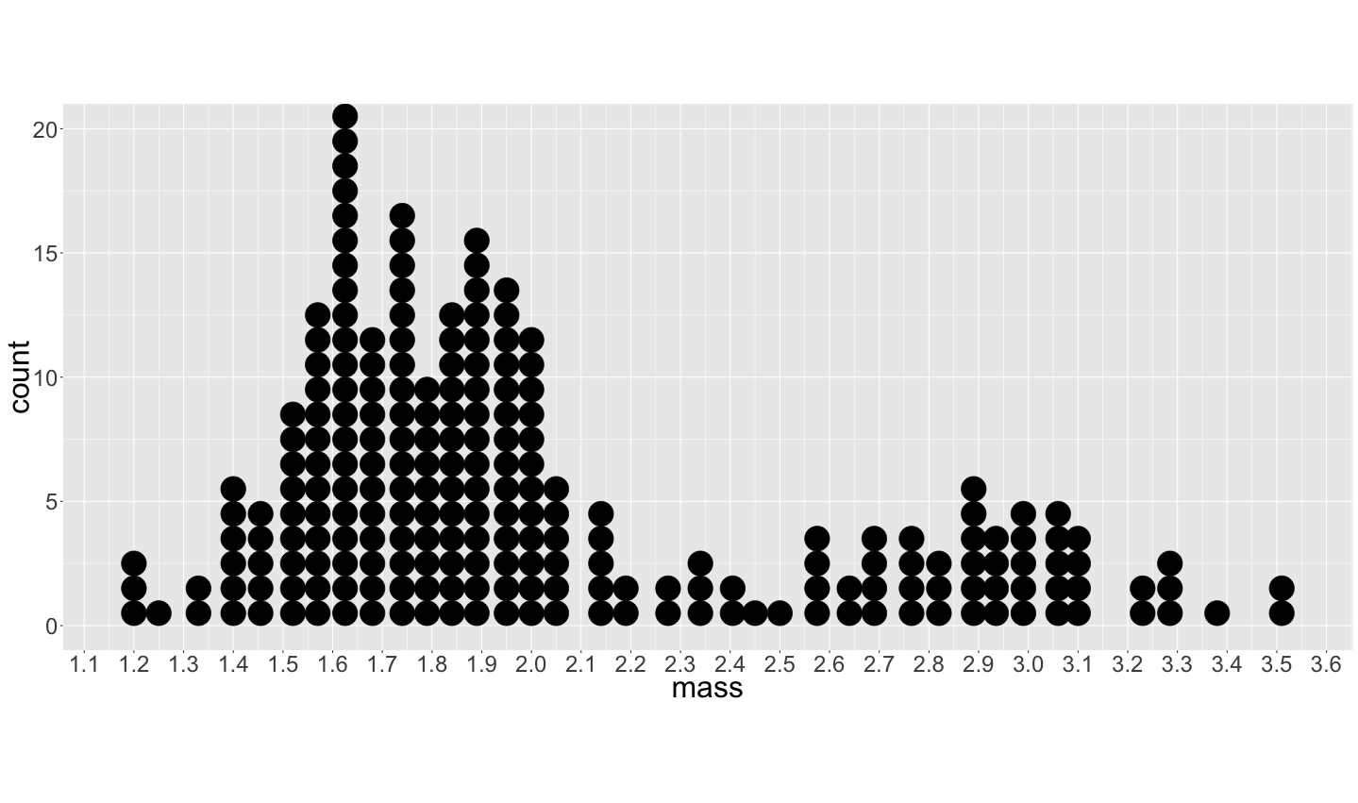

Slide 7
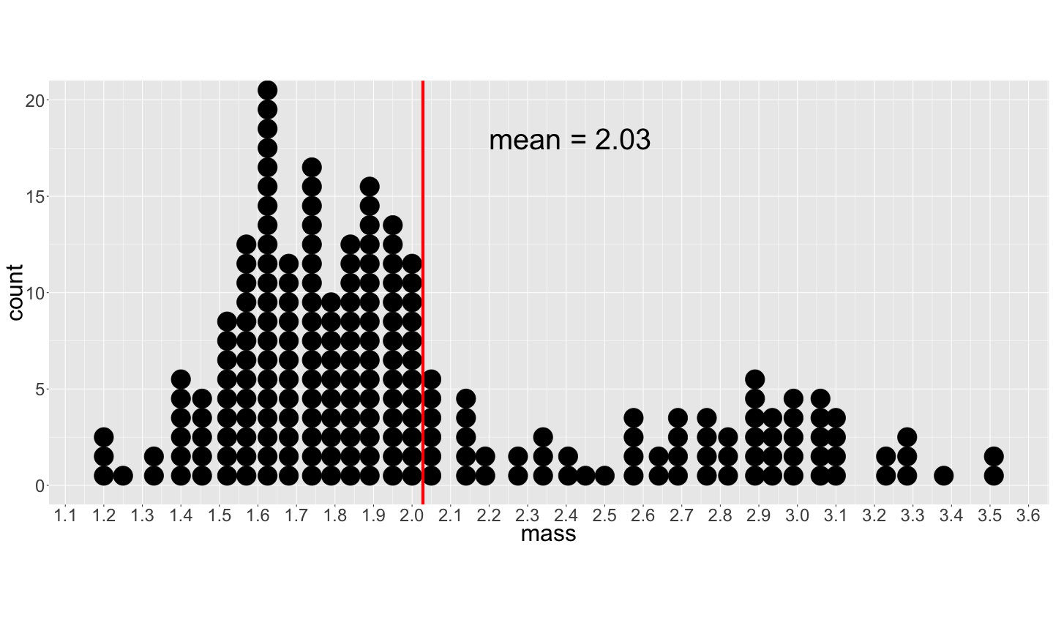

Slide 8
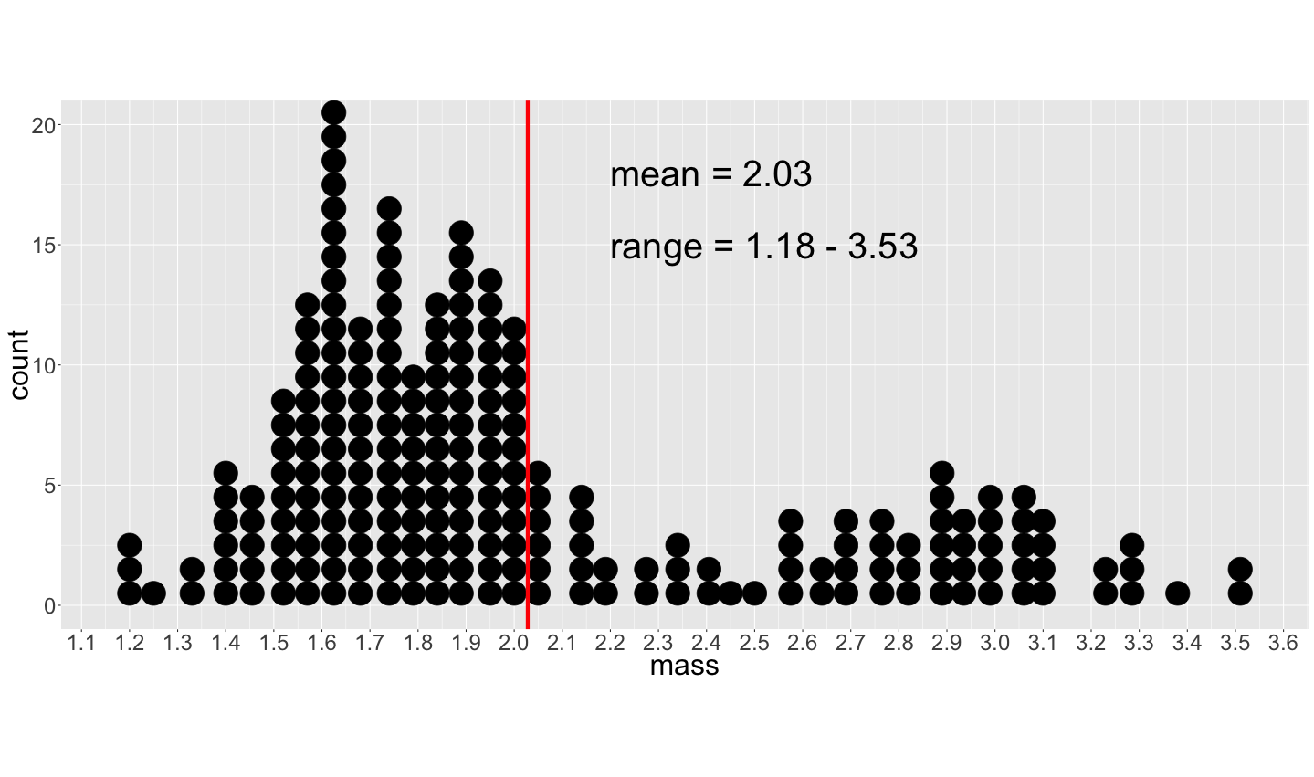

Slide 9
Why use statistics?
Estimate unknown quantities of a population using a sample
Test hypotheses about those parameters/unknown quantities

Slide 10
What is statistics?
Sampling populations
Frequency and probability distributions

Slide 11
Feline High-Rise Syndrome

Slide 12
Feline High-Rise Syndrome
“The diagnosis of high-rise syndrome is not difficult. Typically, the cat is found outdoors, several stories below, and a nearby window or patio door is open” (Ruben 2006)

Slide 13
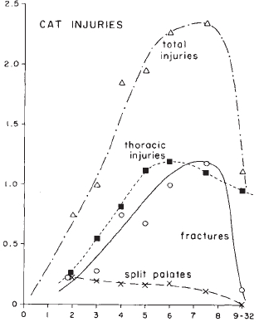
Feline High-Rise Syndrome
Conclusion
After 6-7 floors, terminal velocity is reached and cats relax, lessening the severity of injury on impact
Number of injuries
Number of stories fallen

Slide 14
Feline High-Rise Syndrome
Exercise:
With your neighbour, discuss any potential problems you see with this design?
Do you agree with the conclusions of the authors? Why or why not?

Slide 15
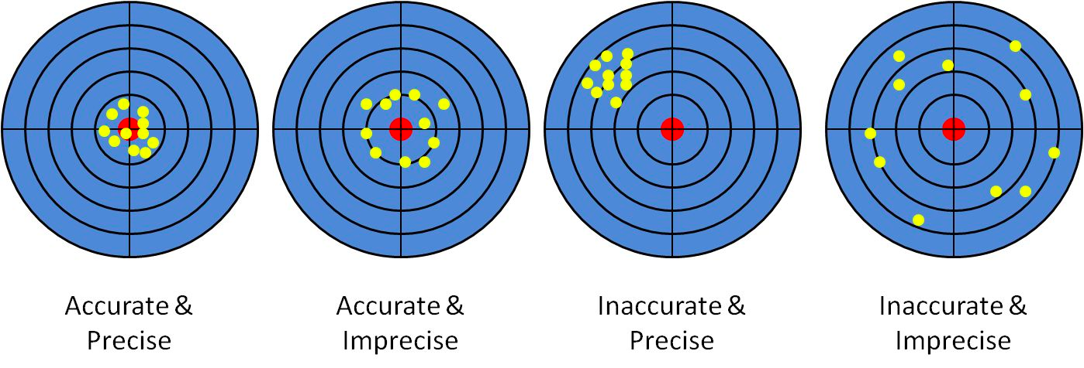
Accuracy and Precision
https://bobchoat.files.wordpress.com/2014/01/accurate-precise1.jpg

Slide 16
Accuracy and Precision
https://bobchoat.files.wordpress.com/2014/01/accurate-precise1.jpg

Slide 17
Accuracy and Precision
https://bobchoat.files.wordpress.com/2014/01/accurate-precise1.jpg

Slide 18
Accuracy and Precision
https://bobchoat.files.wordpress.com/2014/01/accurate-precise1.jpg

Slide 19
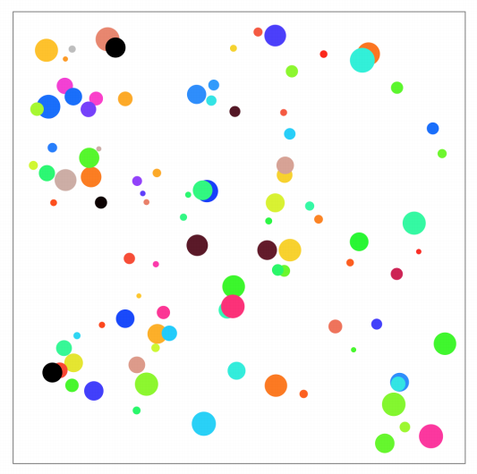
How do you sample a population?

Slide 20
How do you sample a population?

Slide 21
Sampling should be
Random – each individual has an equal chance of selection
Independent selection of individuals
Sufficiently Large
From: http://www.zoology.ubc.ca/~whitlock/bio300/overheads/overheads01.pdf

Slide 22
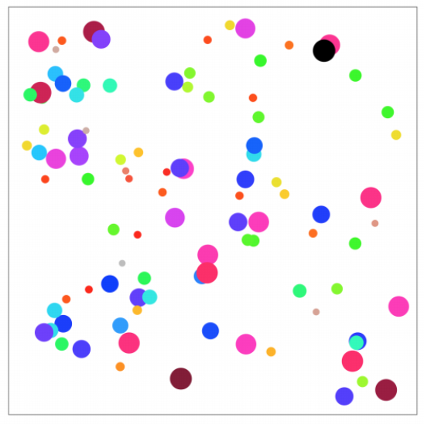
What if you sample by colour?
Notes:
All the same size

Slide 23
What if you sample by colour?
Notes:
All the same size

Slide 24
What if you sample by colour?
Only one size is observed
Notes:
All the same size

Slide 25
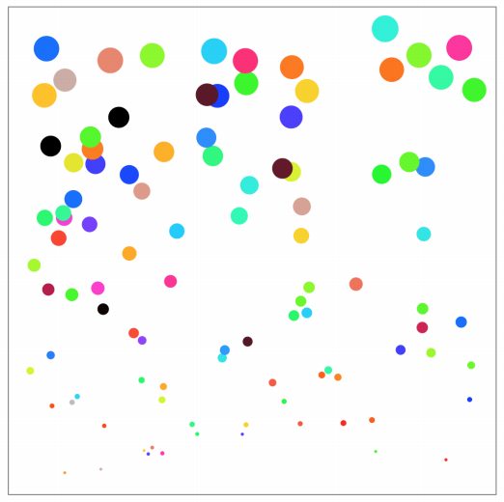
What if there is a gradient?
Notes:
All the same size

Slide 26
What if there is a gradient?
Stratified sampling
Notes:
All the same size

Slide 27
What if there is a gradient?
Stratified sampling
Random
Notes:
All the same size

Slide 28
Sampling should be
Random – each individual has an equal chance of selection
Independent selection of individuals
Sufficiently Large
From: http://www.zoology.ubc.ca/~whitlock/bio300/overheads/overheads01.pdf

Slide 29
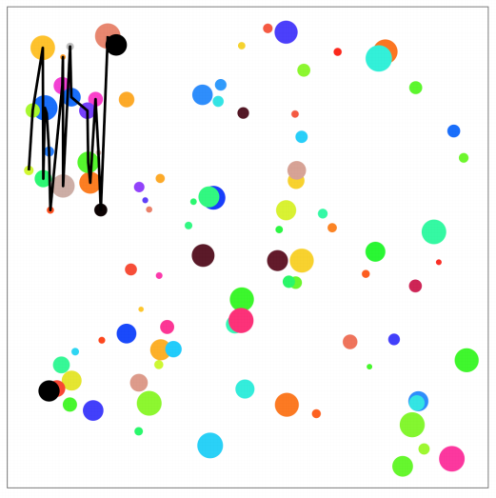
Non-independence
Could be interactions between individuals

Slide 30
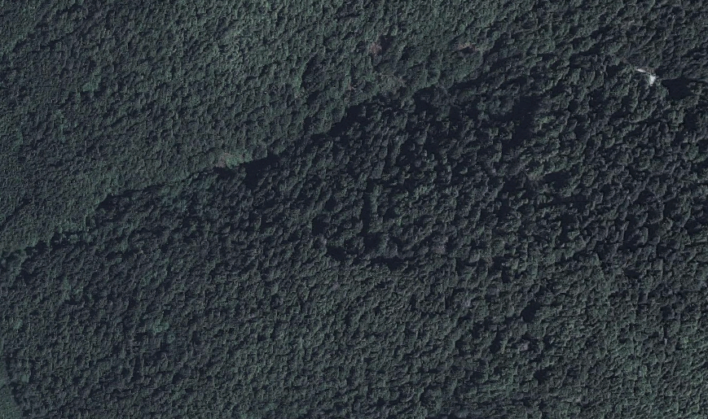
Exercise: How might you sample tree diameter?

Slide 31
Exercise: How might you sample tree diameter?
1 | 2 | 3 | 4 | 5 | 6 | 7 | 8 | 9 | 10
11 | 12 | 13 | 14 | 15 | 16 | 17 | 18 | 19 | 20
21 | 22 | 23 | 24 | 25 | 26 | 27 | 28 | 29 | 30
31 | 32 | 33 | 34 | 35 | 36 | 37 | 38 | 39 | 40
41 | 42 | 43 | 44 | 45 | 46 | 47 | 48 | 49 | 50
51 | 52 | 53 | 54 | 55 | 56 | 57 | 58 | 59 | 60
61 | 62 | 63 | 64 | 65 | 66 | 67 | 68 | 69 | 70
71 | 72 | 73 | 74 | 75 | 76 | 77 | 78 | 79 | 80

Slide 32
Exercise: How might you sample tree diameter?
1 | 2 | 3 | 4 | 5 | 6 | 7 | 8 | 9 | 10
11 | 12 | 13 | 14 | 15 | 16 | 17 | 18 | 19 | 20
21 | 22 | 23 | 24 | 25 | 26 | 27 | 28 | 29 | 30
31 | 32 | 33 | 34 | 35 | 36 | 37 | 38 | 39 | 40
41 | 42 | 43 | 44 | 45 | 46 | 47 | 48 | 49 | 50
51 | 52 | 53 | 54 | 55 | 56 | 57 | 58 | 59 | 60
61 | 62 | 63 | 64 | 65 | 66 | 67 | 68 | 69 | 70
71 | 72 | 73 | 74 | 75 | 76 | 77 | 78 | 79 | 80

Slide 33
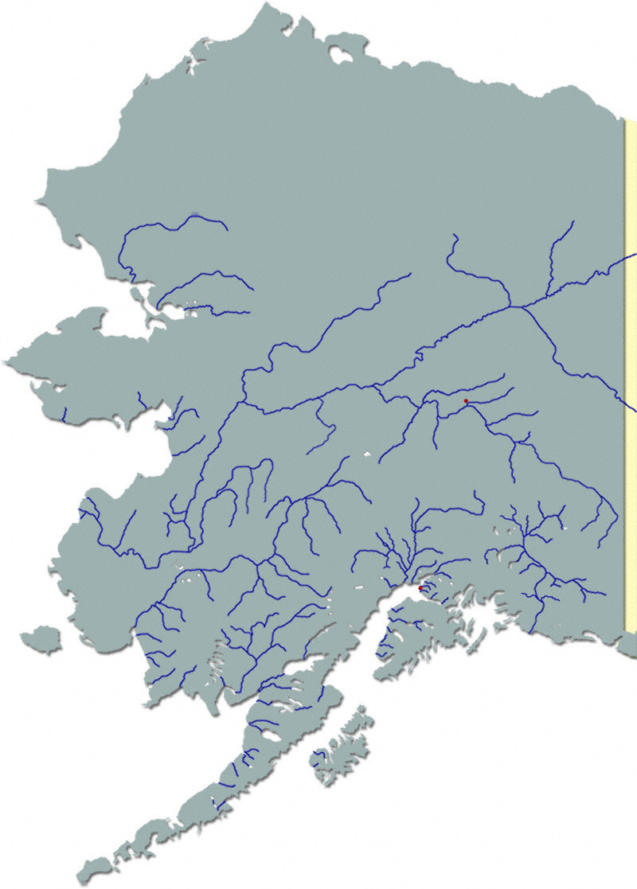
Possible sample design exercise

Slide 34
What about in all these rivers?

Slide 35
What about in all these rivers?
Exercise:
What is the population?
How might you sample this population?
Why?

Slide 36
What is statistics?
Sampling populations
Frequency and probability distributions

Slide 37
Frequency distributions
intervals | frequency
[1.18, 1.23] | 3
(1.23, 1.28] | 1
(1.28, 1.33] | 1
(1.33, 1.38] | 1
(1.38, 1.43] | 6
(1.43, 1.48] | 5
(1.48, 1.53] | 4
(1.53, 1.58] | 11
(1.58, 1.62] | 21
(1.62, 1.68] | 13
(1.68, 1.73] | 12
(1.73, 1.78] | 15
Notes:
Sample.

Slide 38
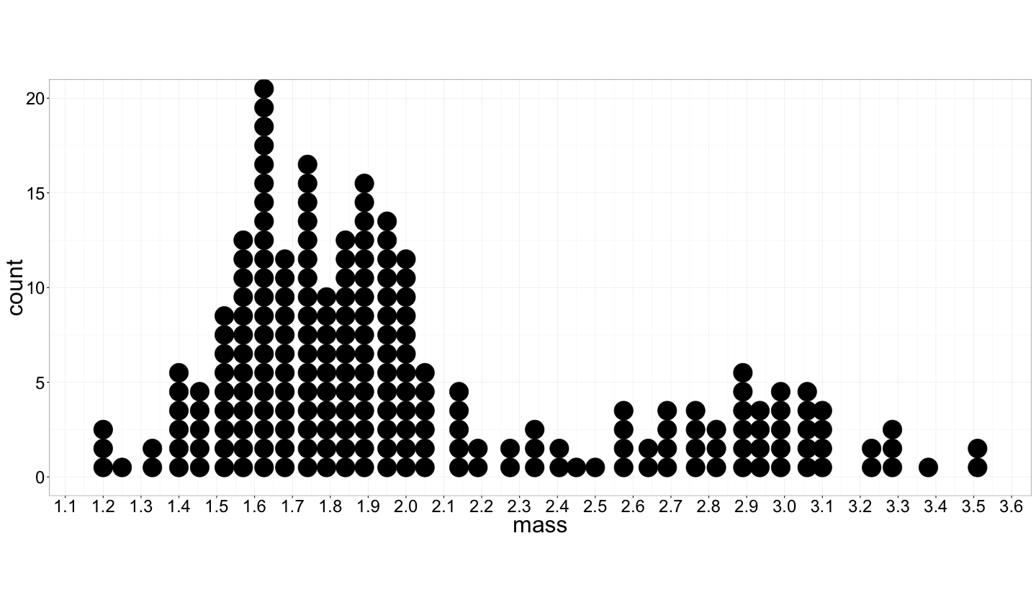
Frequency distributions
intervals | frequency
[1.18, 1.23] | 3
(1.23, 1.28] | 1
(1.28, 1.33] | 1
(1.33, 1.38] | 1
(1.38, 1.43] | 6
(1.43, 1.48] | 5
(1.48, 1.53] | 4
(1.53, 1.58] | 11
(1.58, 1.62] | 21
(1.62, 1.68] | 13
(1.68, 1.73] | 12
(1.73, 1.78] | 15

Slide 39
Probability distributions
Frequency → sample distribution
Notes:
Sample.

Slide 40
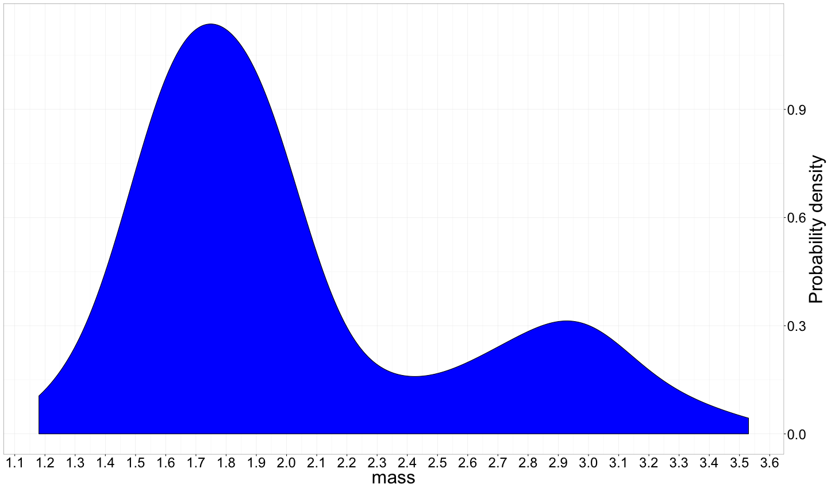
Probability distributions
Probability → population distribution
0.9
0.6
Probability Density
0.3
0
Notes:
Sample.

